Slide 1
A CASE STUDY: WRITING A SPANISH DICTIONARY AS A COLLABORATIVE TASK AMONG BEGINNER STUDENTS
Nuria López
Newcastle University

Slide 2
Background: why this study?
► to enhance vocabulary acquisition
► to change attitude/approach towards vocabulary learning
Task proposed: create your own Spanish dictionary as a collaborative task

Slide 3
Research questions
1. Has this task improved students’ vocabulary acquisition?
2. Has this task had any impact on the students’ approach to vocabulary learning? Do they think the task was useful?
3. Have students enjoyed this task? Do they think it should be introduced in their course?

Slide 4
Setting and participants
GROUP A (15 participants)
7 male 8 female
Native language: 7 English, 2 Chinese, 2 Cantonese, 1 Lithuanian, 1 Hindi,
1 Vietnamese, 1 Russian/Kazakh
30 PARTICIPANTS
Business Spanish 1
Beginner
Undergraduate (2nd year)
Age 19-23
3 hours Spanish/week
GROUP B (15 participants)
7 male 8 female
Native language: 7 English, 5 Chinese, 1 Vietnamese, 1 Czech, 1 Arabic

Slide 5
12-WEEK STUDY
Feb-May 2012
WEEKS 1-6
Group A (experimental group) prepare their dictionary
Group B (control group)
WEEKS 7-12
Group B (experimental group) prepare their dictionary
Group A (control group)
WEEK 6
Group A’s dictionary is finished
Vocabulary Test 1: ALL students
WEEK 12
Group B’s dictionary is finished
Vocabulary Test 2: ALL students

Slide 6
Procedure: the dictionaries
Students’ role:
► Choose words and prepare entries
► Collaboration
Teacher’s role:
► Edit the dictionary (weekly update)
► Check information in the entries
► Guidance

Slide 7
Spanish | Empresa
English | company
Grammar | LA empresa (feminine noun)
Example | La empresa tiene 4.000 empleados.
Synonyms Antonyms | La compañía (sin.)
Other Information (register, related words, image, etc.) | empresario/a: businessman/businesswoman (Ciencias) Empresariales: Business Studies

Slide 8
AGENDA
English | Diary
Grammar | LA agenda (feminine noun)
Example | Tengo la agenda muy ocupada esta semana. ¿Qué tienes en tu agenda el lunes a las 10?
Synonym
Antonym
Other information (register, image, related words, etc.)

Slide 9
NEGOCIO
English | Business
Grammar | EL negocio (masculine noun)
Example | Tengo un negocio de compraventa de coches. Muchos países hacen negocios con China en estos momentos.
Synonym
Antonym
Other information (register, image, related words, etc.) | EL comercio: trade LA empresa: company LA comida de negocios: business lunch EL/LA empresaria or EL hombre de negocios/LA mujer de negocios: businessman/woman EL artículo: product

Slide 10
Group A dictionary: 208 words
Group B dictionary: 243 words

Slide 11
Results
Vocabulary Tests: week 6 & 12
Vocabulary seen in the 6 previous weeks
Question 1: receptive vocabulary
Questions 2 and 3: productive vocabulary
Research question 1
Has this task improved students’ vocabulary acquisition?

Slide 12
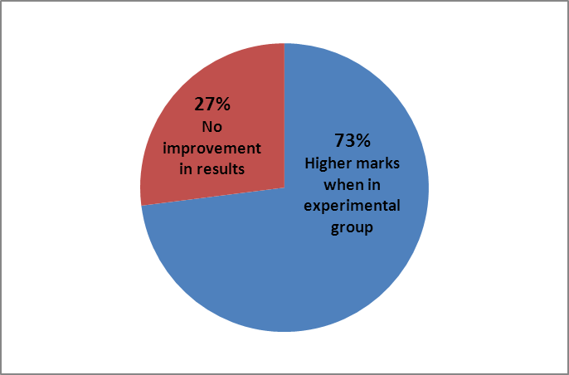
Percentage of students who got higher marks when in experimental group

Slide 13
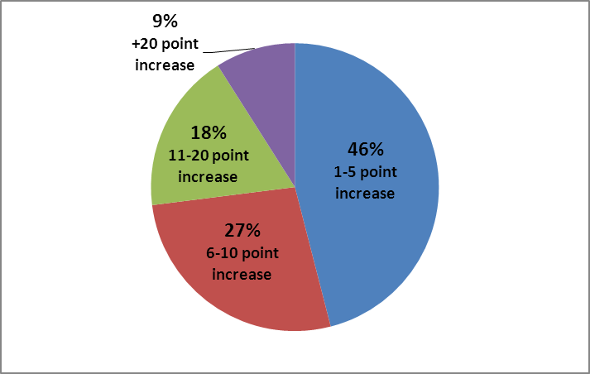
Percentage of students in relation to mark increase

Slide 14
Percentage of students with higher marks in Q1, Q2 and Q3
Q1: 66.6%
Q2: 63.6%
Q2: 63%

Slide 15
Research question 1
Has this task improved students’ vocabulary acquisition?
► Yes, it has for high percentage of students (although with irregular mark increases)
► It has also improved both receptive and productive vocabulary

Slide 16
Results
Questionnaire 1: pre-task
Questionnaire 2: post-task
Research question 2
Has this task had any impact on the students’ approach to vocabulary learning? Do they think the task was useful?

Slide 17
Questionnaire 1: pre-task
□ I do not specifically devote time to learn new vocabulary. I learn new words through general practice of the language, ….
□ I specifically devote time to learn new vocabulary
□ regularly (i.e., every week, after a new
topic has been covered in class, etc.)
□ when revising for assignments
□ other? (Please explain below)

Slide 18
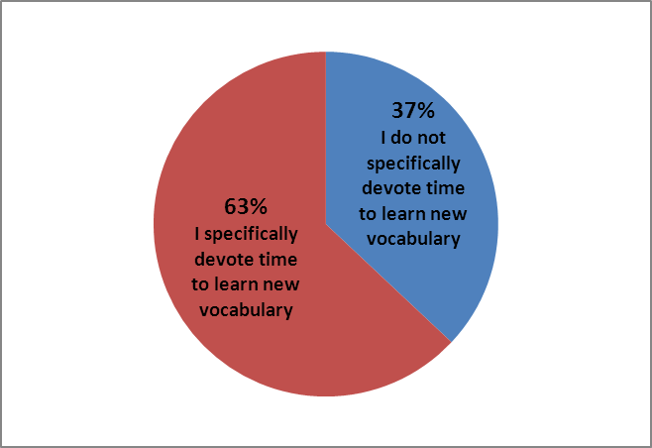

Slide 19
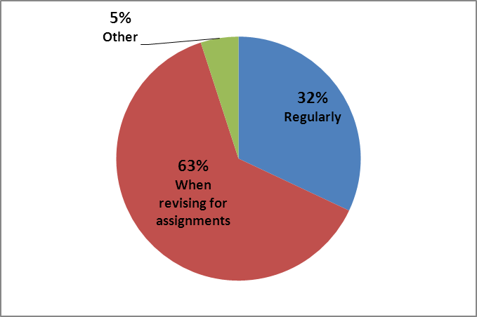

Slide 20
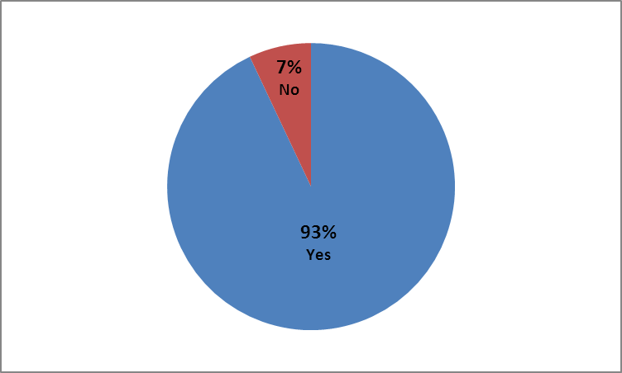
Questionnaire 2: post-task
Do you think that, as a result of your participation in the task, you will devote more time to learn Spanish vocabulary in the future?

Slide 21
Questionnaire 2: post-task
□ I think my participation helped me to learn more words in Spanish.
□ I think my participation helped me to learn more words in Spanish and to understand better how to use them.
□ I think my participation did not help me to learn more words in Spanish, but it did help me to understand better how to use the words I learnt.
□ I think my participation did not help me to learn more words in Spanish or to understand better how to use them.

Slide 22
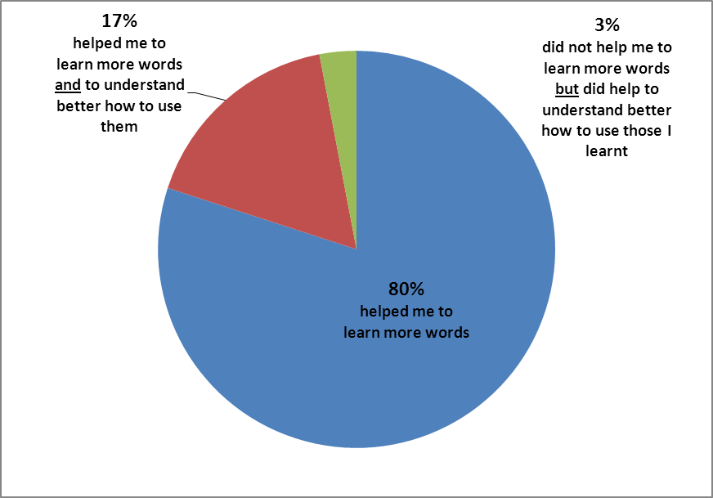

Slide 23
Questionnaire 2: post-task
Do you think you benefited from doing this task in a group?

Slide 24
Everyone’s different ideas helped in gathering new vocab.
It made me do it. More motivation.
Yes, because it makes you do it, otherwise might not try hard enough.
Provides a better range of vocabulary.
More people meant more words and definitions.
Less pressure on individual.

Slide 25
Research question 2
Has this task had any impact on the students’ approach to vocabulary learning? Do they think they task was useful?
► Most students intend to devote more time to vocabulary learning
► All students think task was useful
► Most students think they benefited from working in a group

Slide 26
Results
Questionnaire 2: post-task
Research question 3
Have students enjoyed this task? Do they think it should be introduced in their course?

Slide 27
Questionnaire 2: post-task
Did you enjoy doing this task?

Slide 28
Yes, a different way of learning new words.
Keeping track of Spanish. As we only have 3 hours seminar per week, doing the task helped me memorise the Spanish.
It was useful to group the vocab we’d learnt together.
Interesting way of learning, unusual.

Slide 29
Questionnaire 2: post-task
Do you think a task like this should be introduced in your language course?

Slide 30
Helps you recap key words at the end of each session and provides a good work database.
It is a useful thing to have for revision for exams.
Good for revision at the end of year and encourages learning throughout.
It is very beneficial as by the end we will all have a good amount of vocab to learn and revise for the exam.

Slide 31
Research question 3
Have students enjoyed this task? Do they think it should be introduced in their course?
► Most students enjoyed the task
► Most students would like to have this task in their course

Slide 32
Results: group interviews
Group interviews: week 13 (4 sts.) & week 14 (2 sts.)
► Test as a motivation for learning
► Follow-up activities with the words introduced in the dictionary
► Organise words following textbook units
► Working on the dictionary as part of their homework

Slide 33
Conclusions
► motivation and engagement
► attitude towards vocabulary learning
► (very) significant improvement in some cases
► impact on receptive and productive vocabulary
► improvement achieved in many cases not significant

Slide 34
The road ahead
► complement the dictionary task with follow-up activities
► consider the introduction of vocabulary tests

